Slide 1
Basic HTML

Slide 2
Hypertext Markup Language (HTML)
Describes the content and structure of information on a web page
Not the same as the presentation (appearance on screen)
Surrounds text content with opening and closing tags
Each tag's name is called an element
syntax: <element> content </element>
example: <p>This is a paragraph</p>
Notes:
HTML is the markup language for creating web pages and other information that can be displayed in a web browser
HTML is not a programming language
- most whitespace is insignificant in HTML
Content is the key word for html. It does not describe style!!
Scripts for behavior, css for styling

Slide 3
XHTML
Uses a markup format called XML
XML + HTML = XHTML
Standardized in 2000
A strict XHTML page uses some different syntax and tags than HTML
http://www.w3schools.com/html/html_xhtml.asp

Slide 4
Structure of XHTML page
<!DOCTYPE html PUBLIC "-//W3C//DTD XHTML 1.1//EN"
"http://www.w3.org/TR/xhtml11/DTD/xhtml11.dtd">
<html xmlns="http://www.w3.org/1999/xhtml">
<head>
information about the page
</head>
<body>
page contents
</body>
</html> HTML
HTML is saved with extension .html
Basic structure: tags that enclose content, i.e., elements
Header describes the page
Body contains the page’s contents

Slide 5
Page Title <title>
…
<head>
<title> Harry Potter </title>
</head>
… HTML
Placed within the head of the page
Displayed in web browser’s title mark and when bookmarking the page

Slide 6
Paragraph <p>
…
<body>
<p> Harry Potter and the Deathly Hallows,
the last book in the series, begins directly after the events of the sixth book.
Voldemort has completed his ascension to power and gains control of the Ministry of Magic</p>
</body>
… HTML
Harry Potter and the Deathly Hallows, the last book in the series, begins directly after the events of the sixth book. Voldemort has completed his ascension to power and gains control of the Ministry of Magic
output
Placed within the body of the page
Notes:
Observe that line breaks and spaces do not appear in output

Slide 7
Headings <h1>, <h2>, … <h6>
<h1> Harry Potter </h1>
<h2> Books </h2>
<h3> Harry Potter and the Philosopher’s Stone </h3>
HTML
Harry Potter
Books
Harry Potter and the Philosopher’s Stone
output
Notes:
- Every tag has a meaning. This meaning is related to structure and content, not style!
- H1 is for top level heading, h2 is for sublevel. These are not for size!!!
Why use semantic html? More compatible with browsers, better style

Slide 8
Horizontal rule <hr />
<p> First paragraph </p>
<hr />
<p> Second Paragraph </p>
HTML
First Paragraph
Second Paragraph
output
Should be immediately closed with />
Notes:
Separates sections

Slide 9

Block and Inline Statements
Block elements contain an entire large region of content
examples: paragraphs, lists, table cells
the browser places a margin of whitespace between block elements for separation

Slide 10
Block and Inline Statements (cont.)
Inline elements affect a small amount of content
examples: bold text, code fragments, images
the browser allows many inline elements to appear on the same line
must be nested inside a block element

Slide 11
More HTML tags
Some tags can contain additional information called attributes
syntax: <element attribute="value" attribute="value"> content </element>
example: <a href="page2.html">Next page</a>

Slide 12
More HTML tags
Some tags don't contain content; can be opened and closed in one tag
syntax:
<element attribute="value" attribute="value" />
example: <hr />
example:
<img src=“Harry.jpg" alt="pic of Harry Potter" />

Slide 13
Links <a>
<p>
Search
<a href="http://www.google.com/">Google</a>
now!
</p> HTML
Search Google now! output
The href attribute specifies the destination URL
Links or anchors are inline elements, so they must be placed inside a block element such as a p or h1
Notes:
Choose a descriptive link text!!

Slide 14
More about anchors
<p><a href=“deathlyHallows-book.html">Harry Potter and the Deathly Hallows Book</a></p>
<p><a href="http://en.wikipedia.org”
title="Search">Wikipedia</a></p> HTML
Harry Potter and the Deathly Hallows
Wikipedia output
Types of URLs that can appear in anchors:
Absolute: to another web site
Relative: to another page on this web site
Notes:
specify a tooltip with the title attribute
to make links that open in new windows, we'll need to learn Javascript (later)

Slide 15
Nesting tags
Bad
<p>
<a href=" deathlyHallows-book.html"> Harry Potter and the Deathly Hallows Book </p>
<p>
This text also links to Harry Potter Book</a>
</p> HTML
Tags must be correctly nested: a closing tag must match the most recently opened tag
The browser may render it correctly anyway, but it is invalid XHTML

Slide 16

Images <img>
<img src="images/harrypotter.jpg" alt=“Harry Potter Series" /> HTML
The src attribute specifies source of the image URL
XHTML also requires an alt attribute describing the image
Notes:
Alternative for visually impaired users
Images are not stored with webpage but in a separate folder which can be in directory images

Slide 17

More about images
<a href="http://harrypotter.com/">
<img src="images/dumbledore.jpg" alt=“Dumbledore from Harry Potter"
title="Alas! Ear wax!"/>
</a> HTML
If placed inside an a anchor, the image will become a link
The title attribute specifies an optional tooltip

Slide 18
Line Break <br>
<p>One Ring to rule them all, One Ring to find them, <br /> One Ring to bring them all and in the darkness bind them.</p>
<p> In the Land of Mordor where the Shadows lie. </p> HTML
One Ring to rule them all, One Ring to find them,
One Ring to bring them all and in the darkness bind them
In the Land of Mordor where the Shadows lie.
output
br should be immediately closed with />
br should not be used to separate paragraphs or used multiple times in a row to create spacing
Notes:
This is not a tag with content!
Line break IS NOT paragraph break

Slide 19
Comments <!-- … -- >
<!-- My web page, by Bob Student
CSE 380, Fall 2048 -->
<p>CS courses are <!-- NOT --> a lot of fun!</p> HTML
CS courses are a lot of fun! output
Comments are useful for disabling sections of a page
Comments cannot be nested and cannot contain a --

Slide 20
Phrase elements <em>, <strong>
<p>
HTML is <em>really</em>,
<strong>REALLY</strong> fun!
</p> HTML
HTML is really REALLY fun! output
em: emphasized text (usually in italic)
strong: strongly emphasized text (usually in bold)
The tags must be properly nested for a valid page

Slide 21
Unordered list: <ul>, <li>
<ul>
<li>No shoes</li>
<li>No shirt</li>
<li>No problem!</li>
</ul> HTML
No shoes
No shirt
No problem! output
ul represents a bulleted list of items (block)
li represents a single item within the list (block)

Slide 22
More about unordered lists
<ul>
<li>Harry Potter characters:
<ul>
<li>Harry Potter</li>
<li>Hermione</li>
<li>Ron</li>
</ul>
</li>
<li>LOTR characters:
<ul>
<li>Frodo</li>
<li>Bilbo</li>
<li>Sam</li>
</ul>
</li>
</ul> HTML

Slide 23
More about unordered lists (cont.)
Harry Potter characters:
Harry Potter
Hermione
Ron
LOTR characters:
Frodo
Bilbo
Sam
output

Slide 24
Ordered list <ol>
<p>Apple business model:</p>
<ol>
<li>Beat Microsoft</li>
<li>Beat Google</li>
<li>Conquer the world!</li>
</ol> HTML
Apple business model:
Beat Microsoft
Beat Google
Conquer the world output
ol represents a numbered list of items
we can make lists with letters or Roman numerals using CSS (later)

Slide 25
Common error: Not closing a list
<ul>
<li>No shoes</li>
<li>No shirt</li>
<li>No problem!</li>
<p>Paragraph after list...</p> HTML
No shoes
No shirt
No problem!
Paragraph after list... output
If you leave a list open, subsequent contents will be indented

Slide 26
Common Error: Improper nested list placement
<ul>
<li>Harry Potter characters:</li>
<ul>
<li>Harry Potter</li>
<li>Hermione</li>
<li>Ron</li>
</ul>
</li>
<li>LOTR characters:
<ul>
<li>Frodo</li>
<li>Bilbo</li>
<li>Sam</li>
</ul>
</ul> HTML
closing the outer li too early (or not at all) will render correctly in most browsers, but it is incorrect XHTML

Slide 27
Definition list <dl>, <dt>, <dd>
<dl>
<dt>newbie</dt> <dd>one who does not have mad skills</dd>
<dt>jaded</dt> <dd>tired, bored, or lacking enthusiasm </dd>
<dt>frag</dt> <dd>a kill in a shooting game</dd>
</dl> HTML
newbie
one who does not have mad skills
jaded
Tired, bored, or lacking enthusiasm
frag
a kill in a shooting game output
dl represents a list of definitions of terms
dt represents each term, and dd its definition

Slide 28
Tables <table>, <tr>, <td>
<table>
<tr><td>1,1</td><td>1,2 okay</td></tr>
<tr><td>2,1 real wide</td><td>2,2</td></tr> </table> HTML
output
1,1 | 1,2 okay
2,1 real wide | 2,2
table defines the overall table, tr each row, and td each cell's data
Useful for displaying large row/column data sets
NOTE: tables are sometimes used by novices for web page layout, but this is not proper semantic HTML and should be avoided

Slide 29
Table headers, captions: <th>, <caption>
<table>
<caption>My important data</caption>
<tr><th>Column 1</th><th>Column 2</th></tr> <tr><td>1,1</td><td>1,2 okay</td></tr>
<tr><td>2,1 real wide</td><td>2,2</td></tr>
</table> HTML
output
My important data
Column 1 | Column 2
1,1 | 1,2 okay
2,1 real wide | 2,2
th cells in a row are considered headers
a caption at the start of the table labels its meaning

Slide 30
Quotations <blockquote>
<p>As Lincoln said in his famous Gettysburg Address:</p>
<blockquote>
<p>Fourscore and seven years ago, our fathers brought forth
on this continent a new nation, conceived in liberty, and
dedicated to the proposition that all men are created equal.</p>
</blockquote> HTML
As Lincoln said in his famous Gettysburg Address:
Fourscore and seven years ago, our fathers brought forth on this continent a new nation, conceived in liberty, and dedicated to the proposition that all men are created equal. output
a lengthy quotation

Slide 31
Inline quotations <q>
<p>Quoth the Raven, <q>Nevermore.</q></p> HTML
Quoth the Raven, “Nevermore.” output
a short quotation
Why not just write the following?
<p>Quoth the Raven, "Nevermore."</p>
We don't use " marks for two reasons:
XHTML shouldn't contain literal quotation mark characters; they should be written as &quot;
using <q> allows us to apply CSS styles to quotations

Slide 32
HTML Character Entities
character(s) | entity
< > | &lt; &gt;
é è ñ | &eacute; &egrave; &ntilde;
™ © | &trade; &copy;
π δ Δ | &pi; &delta; &Delta;
И | &#1048;
" & | &quot; &amp;

Slide 33
Inline quotations <q>
&lt;p&gt;
&lt;a href=&quot;http://google.com/search?q=xenia&amp;ie=utf-8&amp;aq=t&quot;&gt;
Search Google for Xenia
&lt;/a&gt;
&lt;/p&gt; HTML
<p> <a href="http://google.com/search?q=xenia&ie=utf-8&aq=t"> Search Google for Xenia </a> </p> output

Slide 34
Computer code <code>
<p>
The <code>ul</code> and <code>ol</code>
tags make lists.
</p> HTML
The ul and ol tags make lists. output
code: a short section of computer code

Slide 35
Preformatted text <pre>
<pre>
Bill Gates speaks
You will be assimilated
Microsoft fans delirious
</pre> HTML
Bill Gates speaks
You will be assimilated
Microsoft fans delirious output
Displayed with exactly the whitespace / line breaks given in the text
Shown in a fixed-width font by default
Notes:
how would it look if we had instead enclosed it in code tags?

Slide 36
Preformatted text <pre>
<pre><code>
public static void main(String[] args) {
System.out.println("Hello, world!");
}
</code></pre> HTML
public static void main(String[] args) {
System.out.println("Hello, world!");
} output
When showing a large section of computer code, enclose it in a pre to preserve whitespace and a code to describe the semantics of the content
Notes:
how would it look if we had instead enclosed it in code tags?

Slide 37
Web Standards
Why use XHTML and web standards?
more rigid and structured language
more interoperable across different web browsers
more likely that our pages will display correctly in the future
can be interchanged with other XML data: SVG (graphics), MathML, MusicML, etc.
Notes:
It is important to write proper XHTML code and follow proper syntax.

Slide 38

W3C XHTML Validator
<p>
<a href="http://validator.w3.org/check/referer">
<img src="http://www.w3.org/Icons/valid-xhtml11"
alt="Validate" />
</a>
</p> HTML
checks your HTML code to make sure it meets the official strict XHTML specifications
Notes:
more picky than the web browser, which may render malformed XHTML correctly
If page is available, if not, upload from your hard drive

Slide 39
Web page metadata <meta>
<meta name="description"
content=“Harry Potter Official Website." />
<meta name="keywords" content="harry potter, harry potter and the deathly hallows, deathly hallows, ministry of magic, resurrection stone, clock of invisibility" />
<meta http-equiv="Content-Type"
content="text/html; charset=iso-8859-1" /> HTML
information about your page (for a browser, search engine, etc.)
placed in the head of your XHTML page
meta tags often have both the name and content attributes
some meta tags use the http-equiv attribute instead of name
Notes:
Data useful for dreamweaver, frontpage
Also helpful for validator

Slide 40
meta element to aid browser / web server
<meta http-equiv="Content-Type"
content="type of document (character encoding)" />
<meta http-equiv="refresh"
content="how often to refresh the page (seconds)" />
</head> HTML
<meta http-equiv="Content-Type" content="text/html; charset=iso-8859-1" />
the meta refresh tag can also redirect from one page to another:
<meta http-equiv="refresh" content="5;url=http://www.bjp.com" />
why would we want to do this? (example)

Slide 41
meta element to describe the page
<head>
<meta name="author"
content="web page's author" />
<meta name="revised"
content="web page version and/or last modification date" />
<meta name="generator"
content="the software used to create the page" />
</head> HTML
many WYSIWYG HTML editors (FrontPage, PageMaker, etc.) place their names in the meta generator tag

Slide 42
meta element to aid search engines
<head>
<meta name="description"
content="how you want search engines to display your page" />
<meta name="keywords"
content="words to associate with your page (comma separated)" />
</head> HTML
these are suggestions to search engines about how to index your page
the search engine may choose to ignore them (why?)

Slide 43
HTML vs XHTML
The Most Important Differences from HTML:
Document Structure
XHTML DOCTYPE is mandatory
The xmlns attribute in <html> is mandatory
<html>, <head>, <title>, and <body> are mandatory
XHTML Elements
XHTML elements must be properly nested
XHTML elements must always be closed
XHTML elements must be in lowercase
XHTML documents must have one root element
XHTML Attributes
Attribute names must be in lower case
Attribute values must be quoted
Attribute minimization is forbidden

Slide 44
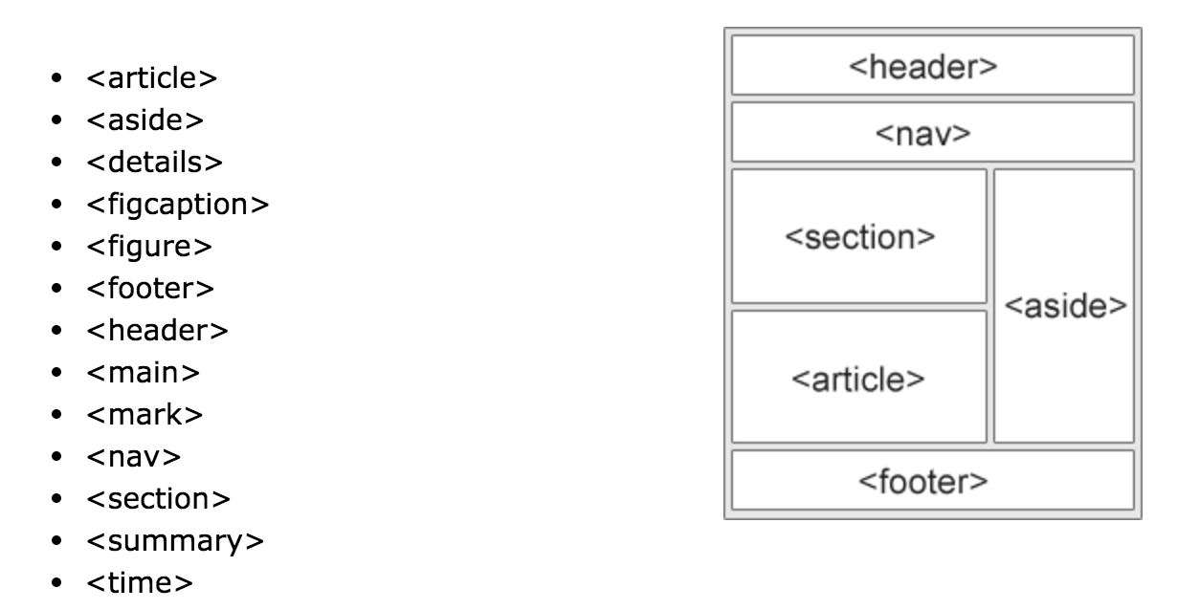
HTML5

